Slide 1

Student Mental Health Analysis EDA
An Exploratory Data Analysis and Machine Learning Approach
Student mental health is increasingly critical as academic pressure, social change, and uncertainty affect wellbeing and performance. Early detection of risk factors can support timely intervention, while data-driven analysis helps identify patterns that inform better student support strategies.
Team:-
HARIKA
LIKITHA
NIKHIL
JAGAN
ATHISH
Department
[BS.c ARTIFICIAL INTELLIGENCE ]

Slide 2
Project Overview
Objectives
Project Workflow
Analyze student mental health survey data to uncover hidden patterns
01
Data Import
Perform Exploratory Data Analysis (EDA) across key demographic variables
Load raw survey dataset into the analysis environment
02
Identify patterns and risk factors affecting student depression
Data Cleaning
Handle missing values, duplicates, and type conversions
Build a Decision Tree model to predict depression outcomes
03
EDA
Visualize distributions and relationships among variables
04
Decision Tree Model
Train and validate classification model using rpart
05
Prediction
Apply model to test data and evaluate performance

Slide 3

Dataset & Features
The dataset comprises student mental health survey responses capturing demographic, academic, and psychological variables used to predict depression status.
Input Features
Psychological & Academic Features
Age
CGPA
Student age range across undergraduate cohorts
Cumulative Grade Point Average — academic performance indicator
Gender
Marital Status
Male / Female classification
Single / Married — social context variable
Course
Anxiety
Field of study / academic discipline
Self-reported anxiety status — Yes / No
Year of Study
Panic Attacks
Current academic year of enrollment
History of panic attacks — Yes / No
Target Variable: Depression — Binary classification: Yes / No. This is the outcome the Decision Tree model is trained to predict.

Slide 4
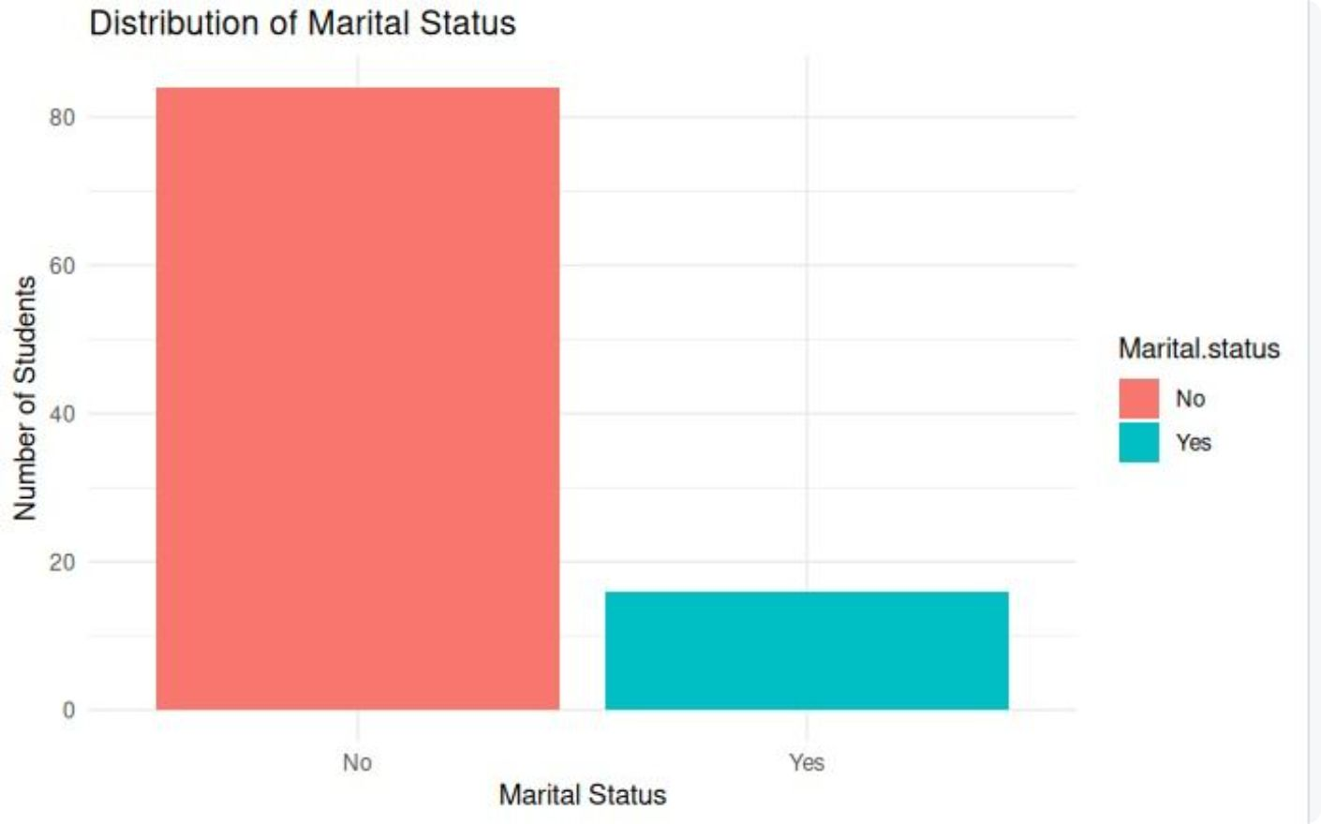
Data Preprocessing
Before analysis, the raw dataset was cleaned and structured to ensure data quality and model reliability.
Preprocessing Steps
Preprocessing Output
1
Missing Value Treatment
Checked all columns for null or blank entries and applied appropriate imputation or removal strategies to maintain dataset integrity.
2
Duplicate Record Removal
Identified and removed duplicate survey responses to prevent bias in analysis and model training.
3
Categorical Encoding
Converted text-based categorical variables (Gender, Course, Depression, etc.) into factor types suitable for R-based machine learning.
4
Clean Dataset Preparation
Finalized a structured, clean dataset ready for EDA visualization and Decision Tree classification.

Slide 5
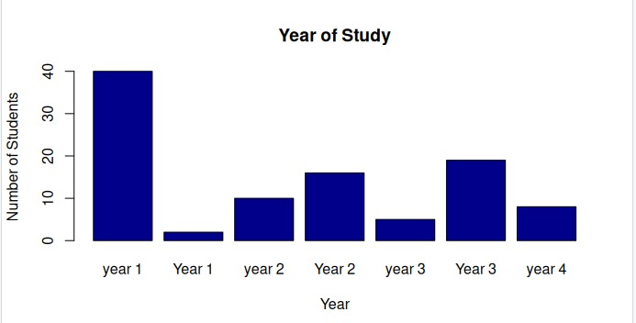
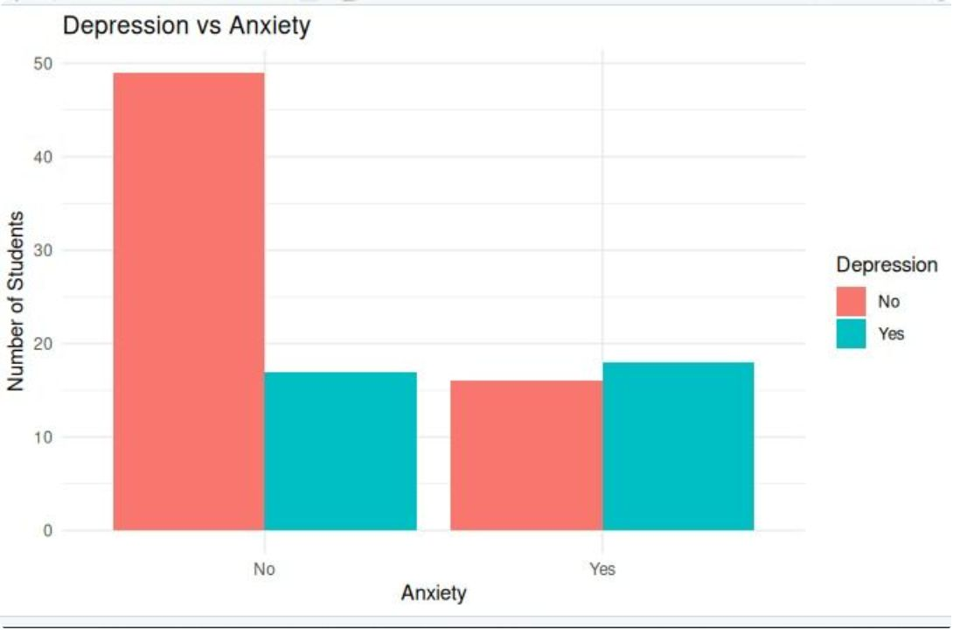
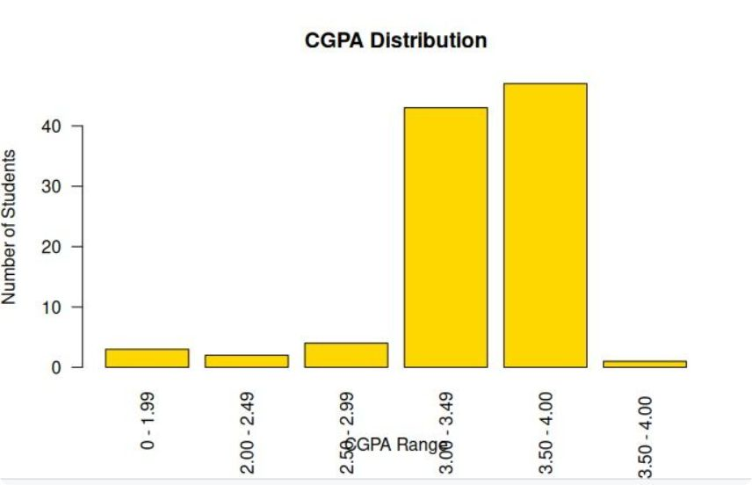
Exploratory Data Analysis
EDA helps identify trends, distributions, and relationships among variables — revealing which factors most strongly associate with student depression.
Depression vs Anxiety
The grouped bar chart reveals a strong co-occurrence of anxiety and depression — students reporting anxiety are significantly more likely to also report depression.
CGPA Distribution
The grouped bars indicates the year of study of the students with their backlogs are there in the same year
f
CGPA distribution across the student population highlights concentration in the 3.00–3.49 range, with lower CGPA bands showing elevated mental health risk indicators.

Slide 6
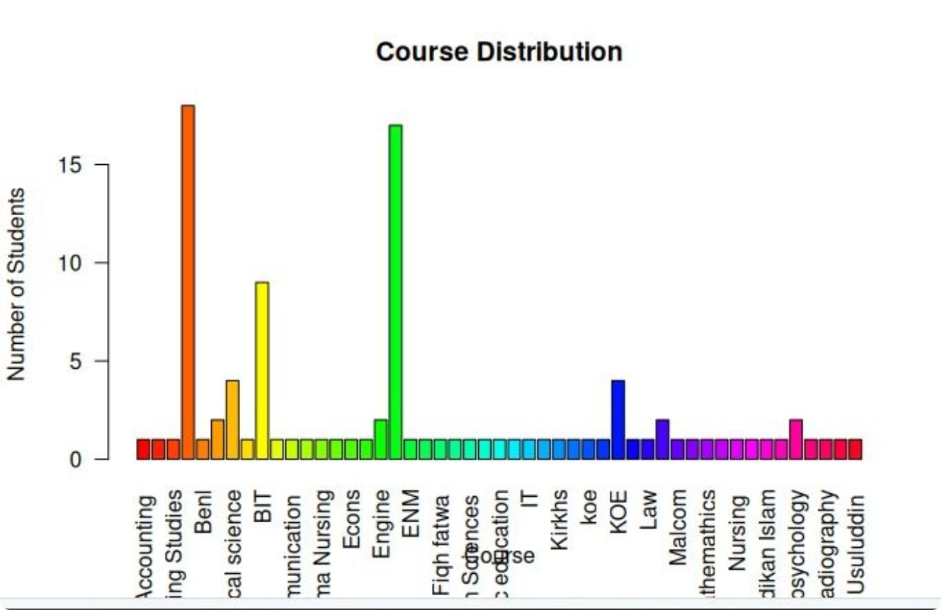
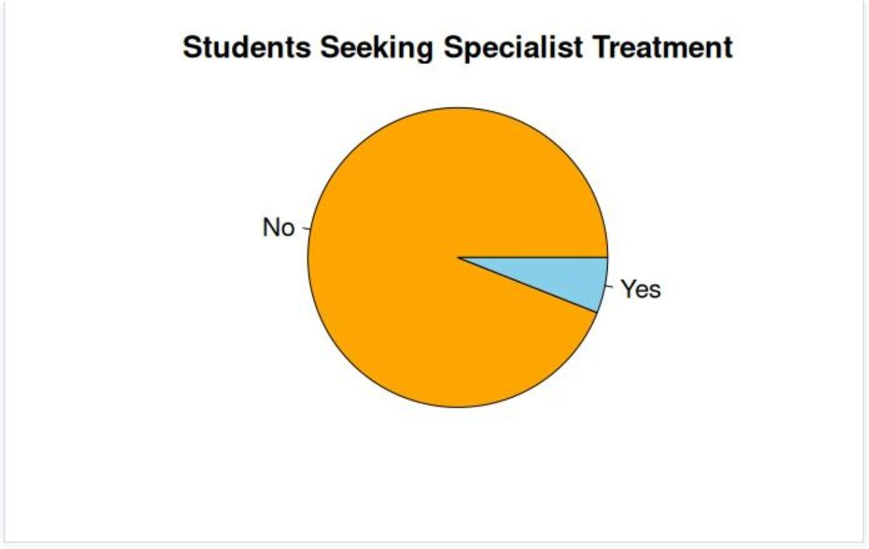

Additional EDA Insights
Further exploratory analysis examines course enrollment patterns and treatment-seeking behavior among students.
Course Distribution
Students Seeking Specialist Treatment
Engineering and BCS students represent the largest cohorts in the dataset, providing a strong sample base for course-level mental health comparisons.
A notable proportion of students have not sought specialist treatment despite reporting mental health symptoms — highlighting a critical gap in campus mental health service utilization.
These EDA findings directly inform feature selection for the Decision Tree model — particularly the strong signal from anxiety status and CGPA on depression outcomes.

Slide 7
Why Decision Tree?
The Decision Tree algorithm was selected as the classification method due to its unique advantages for mental health prediction in an academic context.
Interpretable
Flexible
Feature Selection
Easy to understand and explain to non-technical stakeholders such as university counselors and administrators
Handles both categorical variables (Gender, Anxiety) and numerical variables (CGPA, Age) without preprocessing transformations
Automatically identifies and ranks the most important risk factors contributing to student depression
Multi-variable
Rule-based
Captures complex interactions and relationships between multiple student characteristics simultaneously
Generates clear IF–THEN decision rules that can be directly applied as screening criteria by university support teams

Slide 8

Decision Tree Model
Decision Tree Structure
Model Configuration
Train-Test Split
Algorithm
Depression
Predicted target label
70% Training Data / 30% Testing Data
Decision Tree using rpart package in R
Age under 21?
Yes branch outcome
CGPA above 3.0?
Target Variable
Prediction Basis
No branch outcome
Depression — Binary: Yes / No
Depression predicted using student demographic and psychological characteristics
Anxiety?
Root decision node
The tree uses Anxiety as the primary split, followed by CGPA and Age as secondary decision nodes, producing leaf nodes classified as Depressed or Not Depressed.

Slide 9

Model Evaluation
Model performance is assessed using a Confusion Matrix applied to the 30% held-out test dataset, measuring the accuracy of depression classification.
Evaluation Methodology
Confusion Matrix
1
Confusion Matrix
Predicted: No
Predicted: Yes
Compares predicted depression labels against actual ground-truth labels from the test set, revealing True Positives, True Negatives, False Positives, and False Negatives.
Actual: No
True Negative (TN)
False Positive (FP)
Actual: Yes
False Negative (FN)
True Positive (TP)
2
Accuracy Calculation
Replace TN, FP, FN, TP cells with actual numeric values from your model output to compute final classification accuracy.
Overall correct predictions computed as (TP + TN) / Total — measures the proportion of students correctly classified by the model.
3
Test Dataset Prediction
Model applied to the 30% held-out test data to simulate real-world prediction performance on unseen student records.

Slide 10
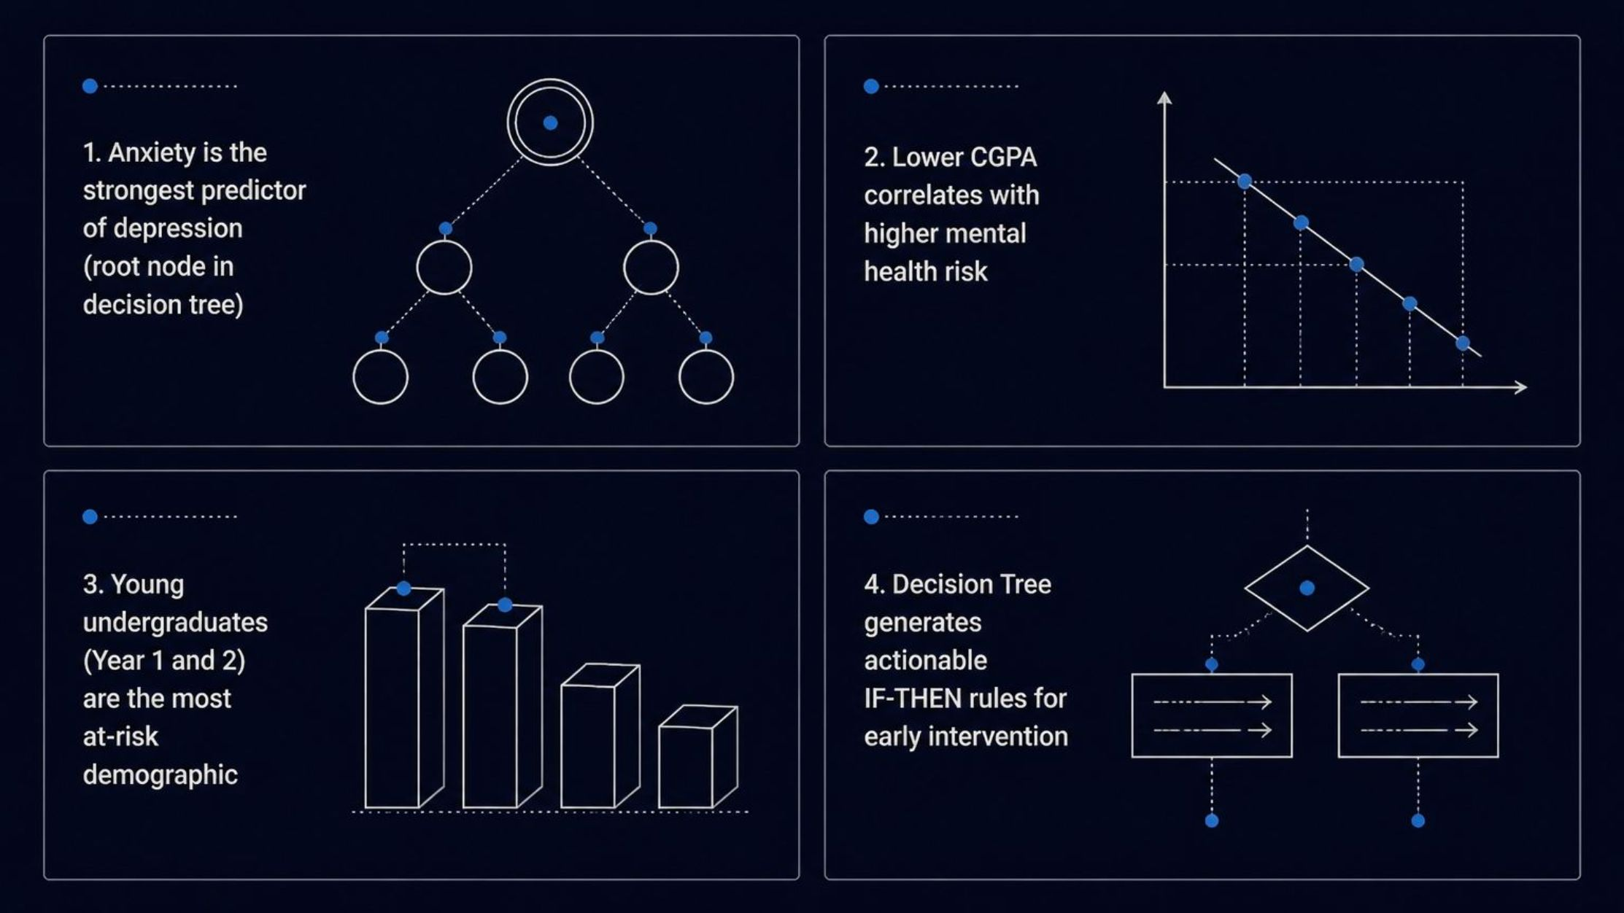
Key Findings
The combined EDA and Decision Tree analysis produced four critical insights into student mental health risk factors.
Anxiety → Depression
CGPA Impact
Anxiety is the strongest predictor of depression among students — serving as the root node in the Decision Tree and the primary risk signal in EDA visualizations.
Lower academic performance (CGPA) correlates strongly with higher mental health risk — students with declining grades are significantly more vulnerable to depression.
At-Risk Group
Model Insight
Young undergraduate students — particularly those in their first and second years — represent the most affected demographic across all mental health indicators.
The Decision Tree successfully identifies high-risk student categories using interpretable IF–THEN rules, enabling practical early intervention by university support services.

Slide 11
Conclusion & Recommendations
Conclusions
Recommendations
EDA revealed important mental health patterns across student demographics, with anxiety and CGPA emerging as dominant variables
Early Screening
Targeted Counseling
Deploy the Decision Tree model as a lightweight screening tool during student enrollment and academic reviews
Prioritize counseling resources for students with low CGPA and reported anxiety — the highest-risk profile
Decision Tree provided accurate and interpretable predictions of depression, generating actionable classification rules
Results can help universities identify at-risk students early — before mental health conditions escalate
Awareness Programs
Continuous Monitoring
Findings support the design of improved, data-driven mental health support programs on campus
Develop mental health awareness campaigns specifically targeting first and second year undergraduates
Retrain the model periodically with updated survey data to maintain prediction accuracy over time
Thank You

